Slide 1
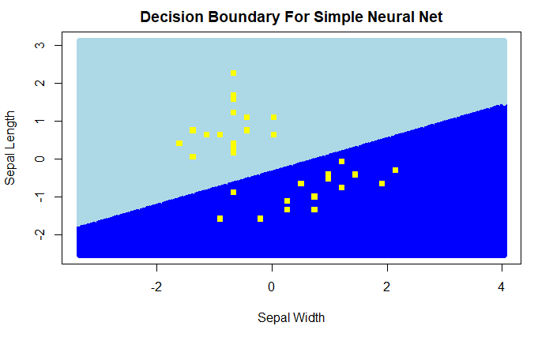
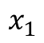
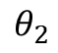
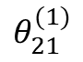
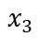
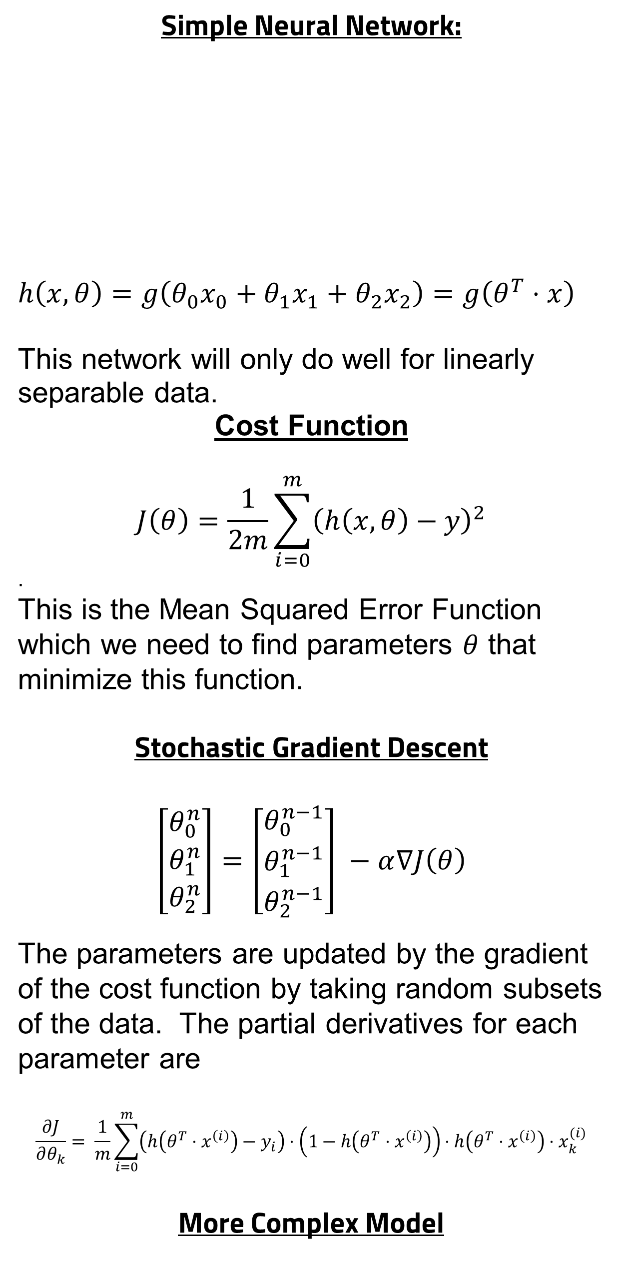
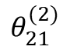
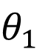
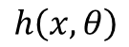
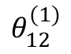
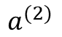
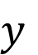
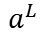
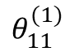
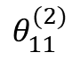
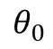
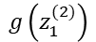
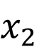
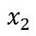
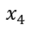
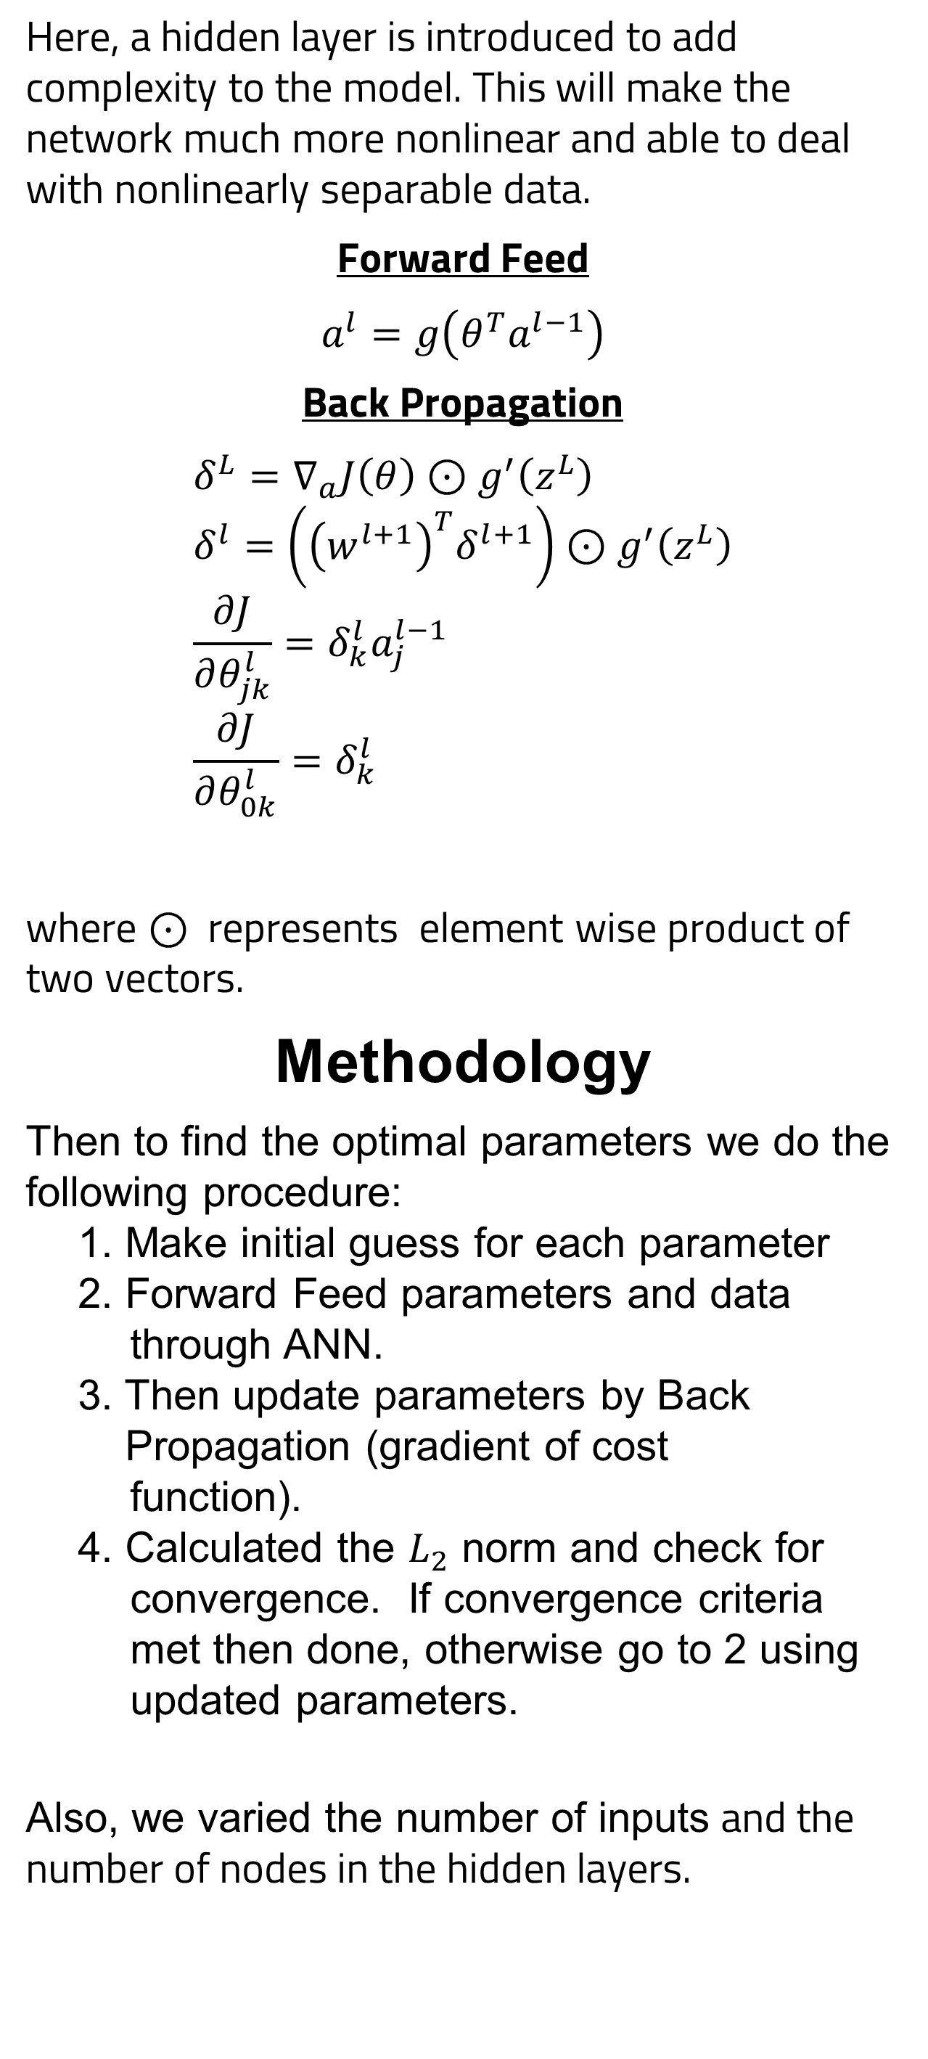
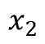
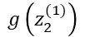
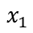
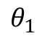
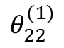
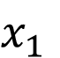
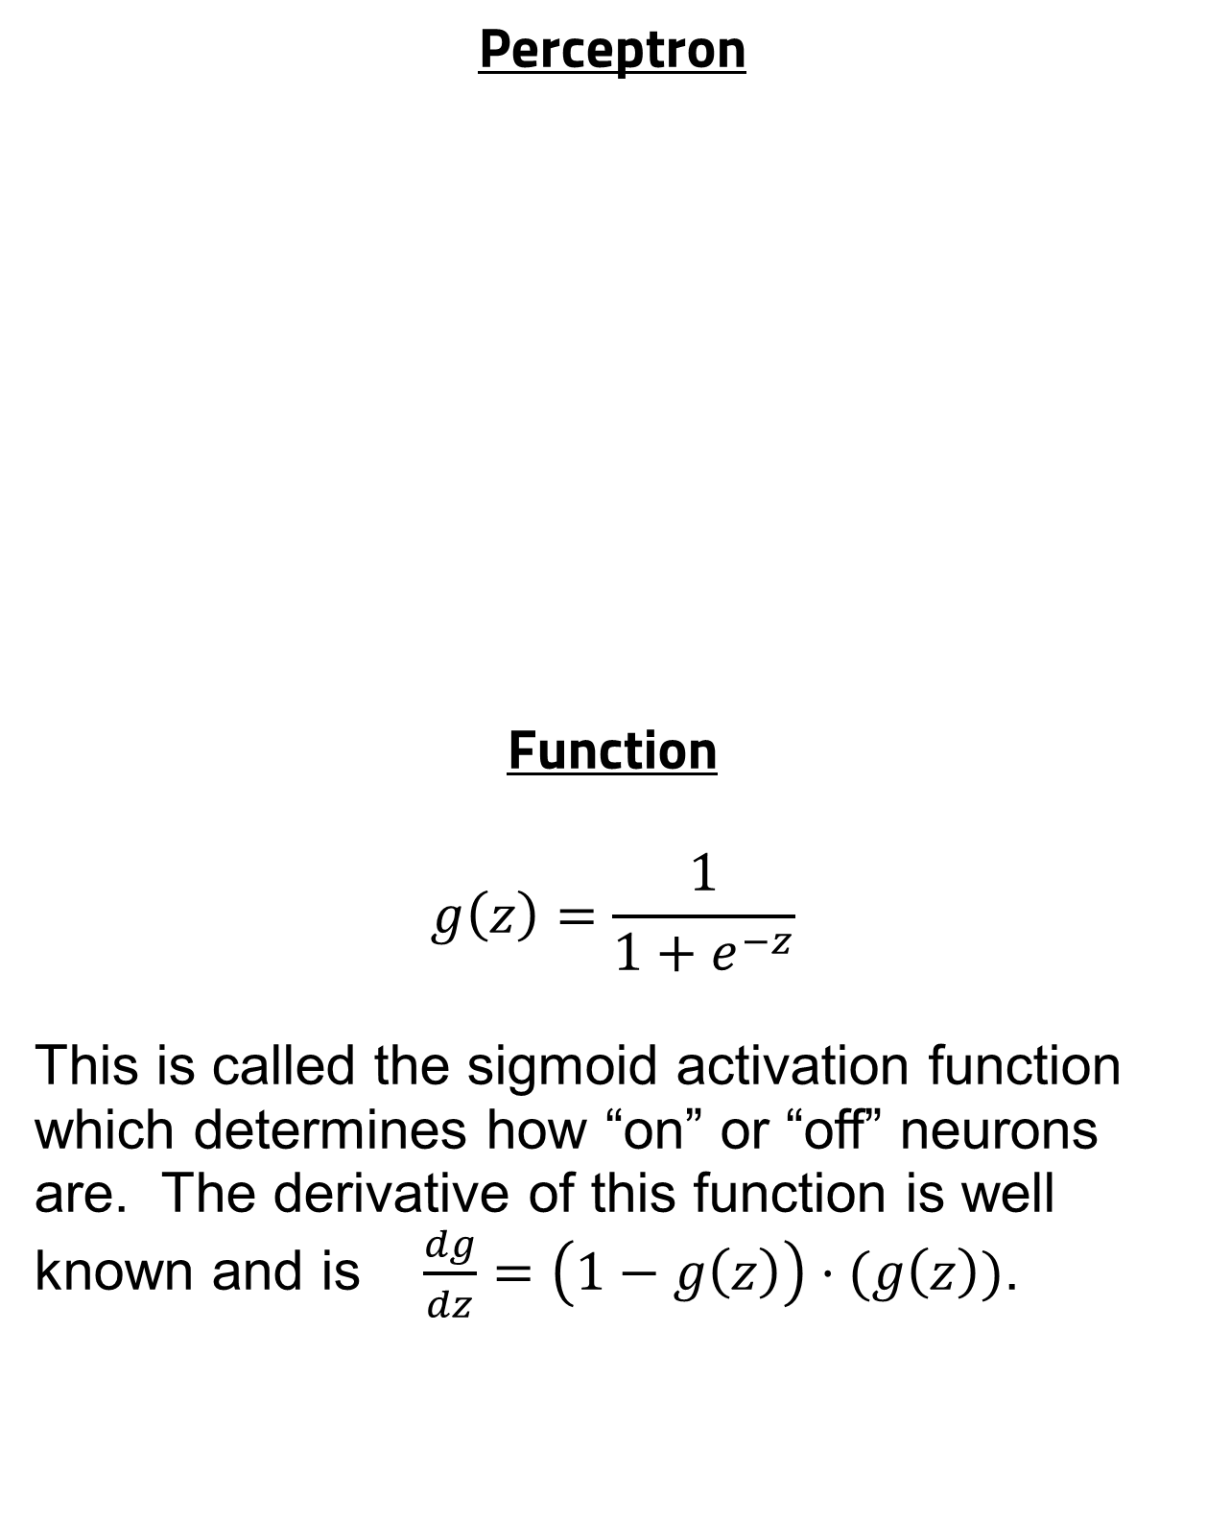
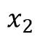
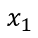
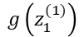
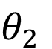
Artificial Neural Networks Via Back Propagation For the Iris Data
Sunny Lee
Advisor: Dr. Micah Schuster and Dr. Barry Husowitz
School of Computing and Data Science
Wentworth Institute of Technology
Abstract
Simple Neural Network:
$$h\left(x,θ\right)=g\left(θ_{0}x_{0}+θ_{1}x_{1}+θ_{2}x_{2}\right)=g\left(θ^{T}⋅x\right)$$
This network will only do well for linearly separable data.
Cost Function
$$J\left(θ\right)=\frac{1}{2m}\sum_{i=0}^{m}{{\left(h\left(x, θ\right)−y\right)}^{2}}$$
.
This is the Mean Squared Error Function which we need to find parameters $θ$ that minimize this function.
Stochastic Gradient Descent
$$\left[\begin{aligned}θ_{0}^{n} \\ θ_{1}^{n} \\ θ_{2}^{n}\end{aligned}\right]=\left[\begin{aligned}θ_{0}^{n−1} \\ θ_{1}^{n−1} \\ θ_{2}^{n−1}\end{aligned}\right] −α∇J\left(θ\right)$$
The parameters are updated by the gradient of the cost function by taking random subsets of the data. The partial derivatives for each parameter are
$$\frac{∂J}{∂θ_{k}}= \frac{1}{m}\sum_{i=0}^{m}{\left(h\left(θ^{T}⋅x^{\left(i\right)}\right)−y_{i}\right)⋅\left(1−h\left(θ^{T}⋅x^{\left(i\right)}\right)\right)⋅h\left(θ^{T}⋅x^{\left(i\right)}\right)⋅x_{k}^{(i)}}$$
More Complex Model
Here, a hidden layer is introduced to add complexity to the model. This will make the network much more nonlinear and able to deal with nonlinearly separable data.
Forward Feed
$$a^{l}=g\left(θ^{T}a^{l−1}\right)$$
Back Propagation
$$δ^{L}=∇_{a}J\left(θ\right)⊙g^{′}\left(z^{L}\right) \\ δ^{l}=\left({\left(w^{l+1}\right)}^{T}δ^{l+1}\right)⊙g^{′}\left(z^{L}\right) \\ \frac{∂J}{∂θ_{jk}^{l}}=δ_{k}^{l}a_{j}^{l−1} \\ \frac{∂J}{∂θ_{0k}^{l}}=δ_{k}^{l}$$
where $⊙$ represents element wise product of two vectors.
Methodology
Then to find the optimal parameters we do the following procedure:
1. Make initial guess for each parameter
2. Forward Feed parameters and data
through ANN.
3. Then update parameters by Back Propagation (gradient of cost function).
4. Calculated the $L_{2}$ norm and check for convergence. If convergence criteria met then done, otherwise go to 2 using updated parameters.
Also, we varied the number of inputs and the number of nodes in the hidden layers.
An example of a different ANN architectures is shown below:
Results
Conclusions
A simple ANN can be used to analyze linearly separable data. However, for more complex and real data a more complicated ANN is needed. As with any machine learning technique overfitting can be a problem. Therefore, one must find the optimal ANN architecture that avoids overfitting. The optimal ANN architecture for the Iris data is 4,6,1.
References
Michael A. Nielsen, “Neural Networks and Deep Learning”, Determination Press, 2015
R. A. Fisher (1936). “The use of multiple measurements in taxonomic problems”. Annals of Eugenics. 7(2): 179-188.
Machine learning and Artificial Neural Networks (ANN) have been used to analyze numerous data sets. An overview of how an ANN works as well as back propagation, steepest descent, and stochastic gradient descent are presented. Furthermore, R-scripts were constructed for two very simple ANN as well as a more complicated ANN using back propagation. The R-scripts were then used to analyze a subset of the famous iris data set which is linearly separable. Furthermore, different ANN architectures were explored to find the optimal ANN for the Iris data.
$$x_{1}$$
$$θ_{1}$$
$$θ_{0}$$
Output
$$x_{1}$$
Input
$$h\left(x, θ\right)$$
$$x_{2}$$
$$x_{2}$$
$$θ_{2}$$
Input
$$a^{L}$$
Output
$$x_{3}$$
$$x_{4}$$
Introduction
Perceptron
Function
$$g\left(z\right)=\frac{1}{1+e^{−z}}$$
This is called the sigmoid activation function which determines how “on” or “off” neurons are. The derivative of this function is well known and is $\frac{dg}{dz}=\left(1−g\left(z\right)\right)⋅(g\left(z\right))$.
Nodes per Layer | Matthew’s Correlation Coefficient
4, 2, 1 | 0.6165339
4, 6, 1 | 1
4, 10, 1 | 0.933025
4, 6, 6, 1 | 0.933025
$$x_{1}$$
$$θ_{1}$$
$$y$$
$$x_{2}$$
$$θ_{2}$$
$$x_{1}$$
$$θ_{11}^{(1)}$$
$$θ_{12}^{(1)}$$
$$g\left(z_{1}^{(1)}\right)$$
$$θ_{11}^{(2)}$$
Input
$$θ_{21}^{(1)}$$
$$g\left(z_{1}^{(2)}\right)$$
$$a^{(2)}$$
Output
$$x_{2}$$
$$θ_{22}^{(1)}$$
$$g\left(z_{2}^{(1)}\right)$$
$$θ_{21}^{(2)}$$

